Slide 1
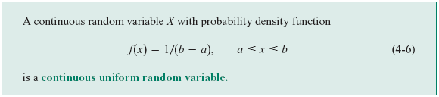




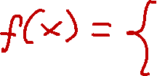
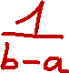






4-5 Continuous Uniform Random Variable
Definition

Slide 2


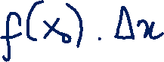

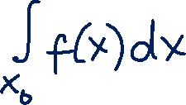
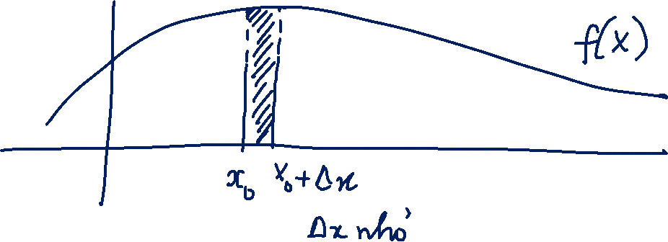




Slide 3

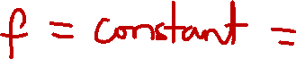
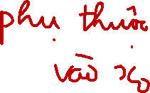



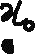
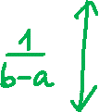
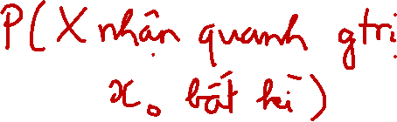
4-5 Continuous Uniform Random Variable
Figure 4-8 Continuous uniform probability density function.

Slide 4

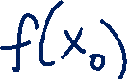







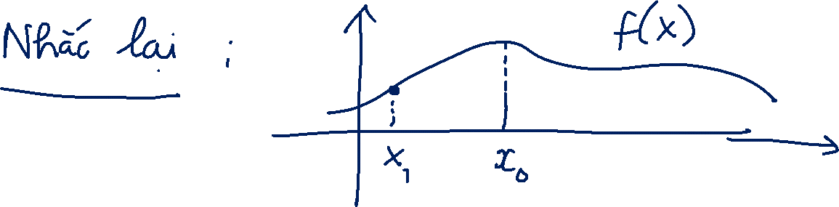

Slide 5


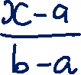


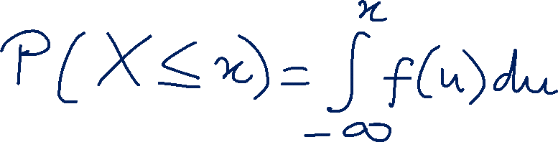


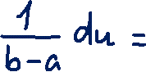



Slide 6

4-5 Continuous Uniform Random Variable
Mean and Variance

Slide 7
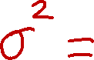
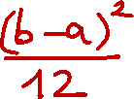


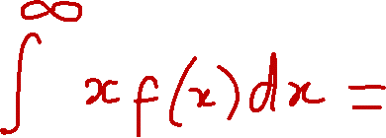
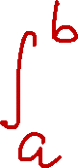
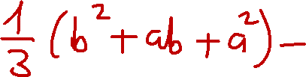
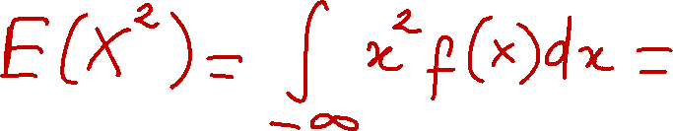
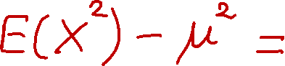
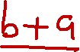
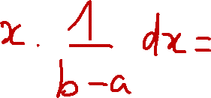
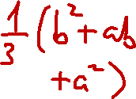
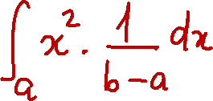
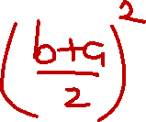

Slide 8








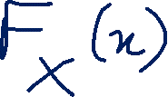

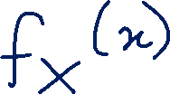






Slide 9
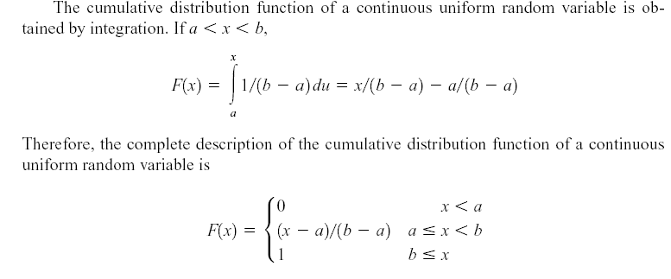
4-5 Continuous Uniform Random Variable

Slide 10
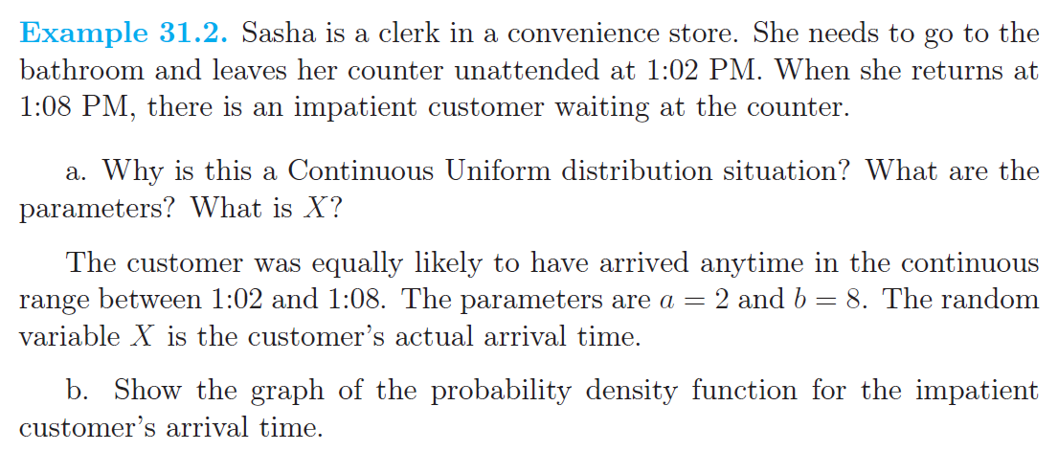



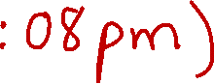







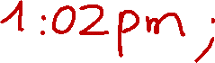

Slide 11

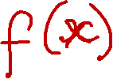



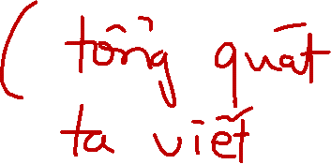







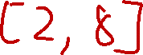
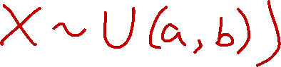
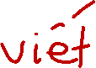
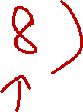
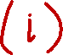
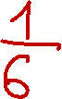


Slide 12
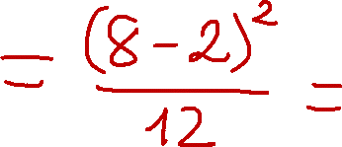
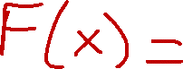

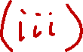

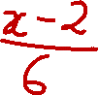
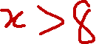


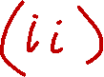
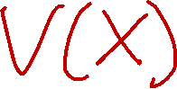
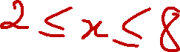





Slide 13











Slide 14

























Slide 15

















Slide 16

























Slide 17





















Slide 18













Slide 19














Slide 20





















Slide 21



















Slide 22

















Slide 23

















Slide 24






















Slide 25




















Slide 26

















Slide 27

















Slide 28










Slide 29












Slide 30










Slide 31


















Slide 32



















Slide 33











Slide 34















Slide 35

















Slide 36




Slide 37




























Slide 38





4-6 Normal Distribution
Definition

Slide 39






Slide 40



















Slide 41




4-6 Normal Distribution
Figure 4-10 Normal probability density functions for selected values of the parameters μ and σ².

Slide 42











Slide 43









4-6 Normal Distribution
Some useful results concerning the normal distribution

Slide 44








4-6 Normal Distribution
Definition : Standard Normal

Slide 45





















Slide 46
















Slide 47

4-6 Normal Distribution
Example 4-11
Figure 4-13 Standard normal probability density function.

Slide 48

4-6 Normal Distribution
Standardizing

Slide 49













Slide 50




4-6 Normal Distribution
Example 4-13

Slide 51

4-6 Normal Distribution
Figure 4-15 Standardizing a normal random variable.

Slide 52
4-6 Normal Distribution
To Calculate Probability

Slide 53

4-6 Normal Distribution
Example 4-14

Slide 54


4-6 Normal Distribution
Example 4-14 (continued)

Slide 55

4-6 Normal Distribution
Example 4-14 (continued)
Figure 4-16 Determining the value of x to meet a specified probability.

Slide 56


















Slide 57

















Slide 58















Slide 59
























Slide 60














Slide 61











Slide 62















Slide 63























Slide 64








Slide 67
4-7 Normal Approximation to the Binomial and Poisson Distributions
Under certain conditions, the normal distribution can be used to approximate the binomial distribution and the Poisson distribution.

Slide 68




4-7 Normal Approximation to the Binomial and Poisson Distributions
Figure 4-19 Normal approximation to the binomial.

Slide 69




4-7 Normal Approximation to the Binomial and Poisson Distributions
Example 4-17

Slide 70










4-7 Normal Approximation to the Binomial and Poisson Distributions
Normal Approximation to the Binomial Distribution

Slide 71














Slide 72














Slide 73









Slide 74





















Slide 75




















Slide 76







Slide 77
























Slide 78











Slide 79



















Slide 83

4-7 Normal Approximation to the Binomial and Poisson Distributions
Example 4-18

Slide 84

4-7 Normal Approximation to the Binomial and Poisson Distributions
Figure 4-21 Conditions for approximating hypergeometric and binomial probabilities.

Slide 85

4-7 Normal Approximation to the Binomial and Poisson Distributions
Normal Approximation to the Poisson Distribution

Slide 91

4-7 Normal Approximation to the Binomial and Poisson Distributions
Example 4-20

Slide 92



Slide 93



Slide 94

4-8 Exponential Distribution
Definition

Slide 98
4-8 Exponential Distribution
Mean and Variance

Slide 101




















Slide 102



Slide 105










Slide 106










Slide 107









Slide 108

4-8 Exponential Distribution
Example 4-21

Slide 109
4-8 Exponential Distribution
Figure 4-23 Probability for the exponential distribution in Example 4-21.

Slide 110

4-8 Exponential Distribution
Example 4-21 (continued)

Slide 111

4-8 Exponential Distribution
Example 4-21 (continued)

Slide 112

4-8 Exponential Distribution
Example 4-21 (continued)

Slide 113
4-8 Exponential Distribution
Our starting point for observing the system does not matter.
An even more interesting property of an exponential random variable is the lack of memory property.
In Example 4-21, suppose that there are no log-ons from 12:00 to 12:15; the probability that there are no log-ons from 12:15 to 12:21 is still 0.082. Because we have already been waiting for 15 minutes, we feel that we are “due.” That is, the probability of a log-on in the next 6 minutes should be greater than 0.082. However, for an exponential distribution this is not true.

Slide 114

4-8 Exponential Distribution
Example 4-22

Slide 115


4-8 Exponential Distribution
Example 4-22 (continued)

Slide 116

4-8 Exponential Distribution
Example 4-22 (continued)

Slide 117


4-8 Exponential Distribution
Lack of Memory Property

Slide 118

4-8 Exponential Distribution
Figure 4-24 Lack of memory property of an Exponential distribution.

Slide 119


Slide 120


Slide 125



